Slide 1

Programming Fundamental
Rameen Shaikh
Raja Muhammad Yahya
Sami Haider
Sara Shahzad

Slide 2
Hotel Management
This project is developed in C language using structures and file handling.
01
The system stores hotel guest records such as name, contact, CNIC, membership, room number, and stay details.
02
Binary file handling (fwrite and fread) is used to save and display customer records efficiently.
03

Slide 3
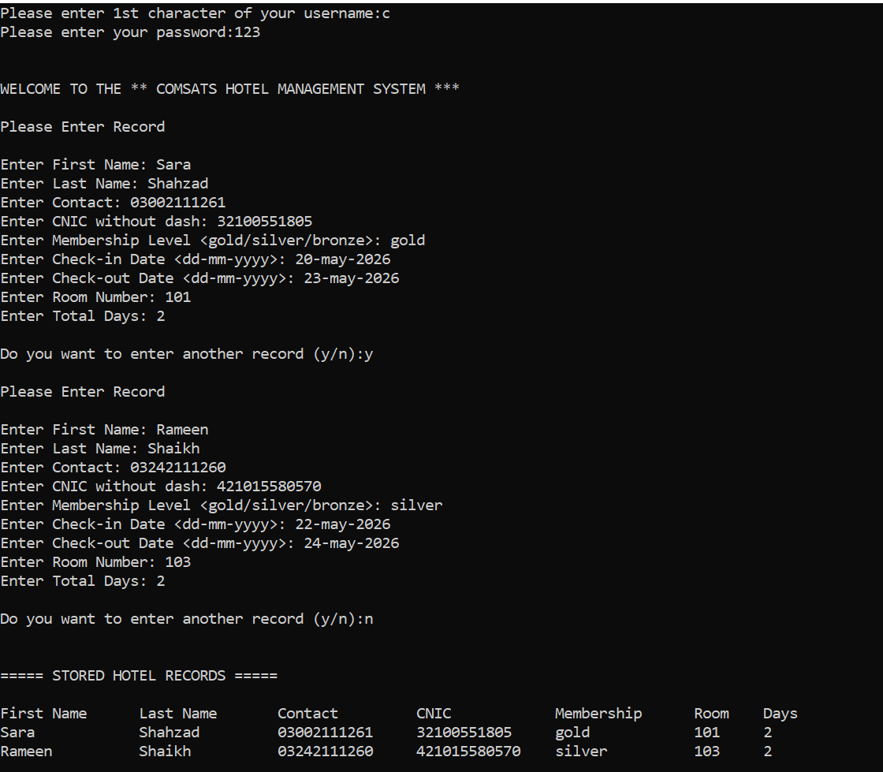
Output
The output shows that the program stores hotel customer records in a file and displays them successfully using file handling in C language.

Slide 4
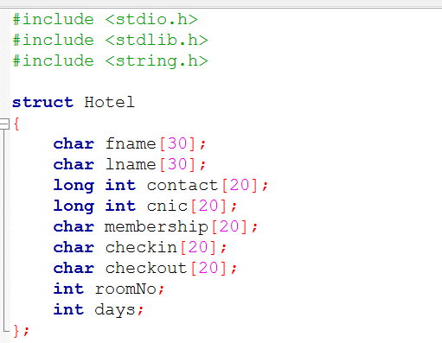
struct Hotel {
A structure named Hotel is created. It stores all customer information together.
char fname[30]; char lname[30];
These variables store the customer's first name and last name.
long int contact[20]; long int cnic[20];
These store the customer's contact number and CNIC number.

Slide 5
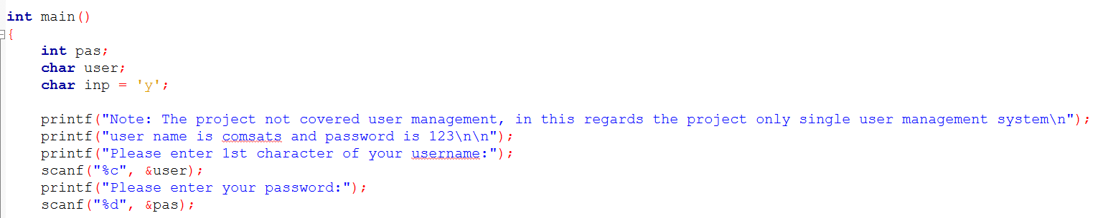
int pas; char user; char inp = ‘y’;
pas stores password. user stores username first character. inp controls the loop for entering more records.
printf("Note: The project not covered user management...");
Displays a message about the project and login details.
scanf("%c", &user); scanf("%d", &pas);
Takes username character and password from the user.

Slide 6
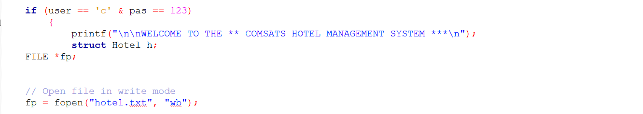
if (user == 'c' & pas == 123)
Checks if username and password are correct.
If correct, the program continues.
printf("WELCOME TO THE COMSATS HOTEL MANAGEMENT SYSTEM");
Displays welcome message after successful login.
struct Hotel h; FILE *fp;
h is a structure variable.
fp is a file pointer used for file handling.
fp = fopen("hotel.txt", "wb");
Creates/open file in binary write mode.
w = write
b = binary

Slide 7
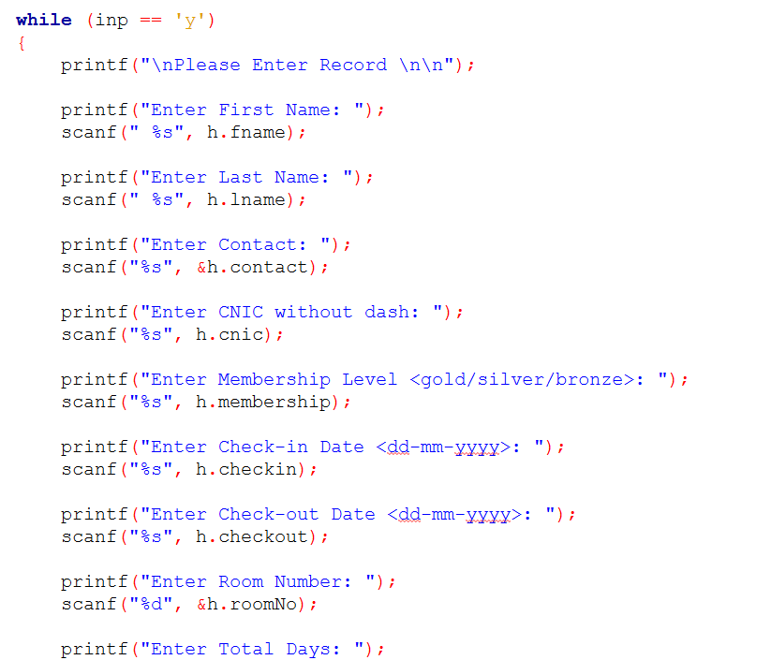
while (inp == 'y’) {
Loop runs while user enters y.
scanf("%s", h.fname); scanf("%s", h.lname);
Takes first name and last name as input.
scanf("%s", &h.contact); scanf("%s", h.cnic);
Takes contact number and CNIC from user.
And so on

Slide 8
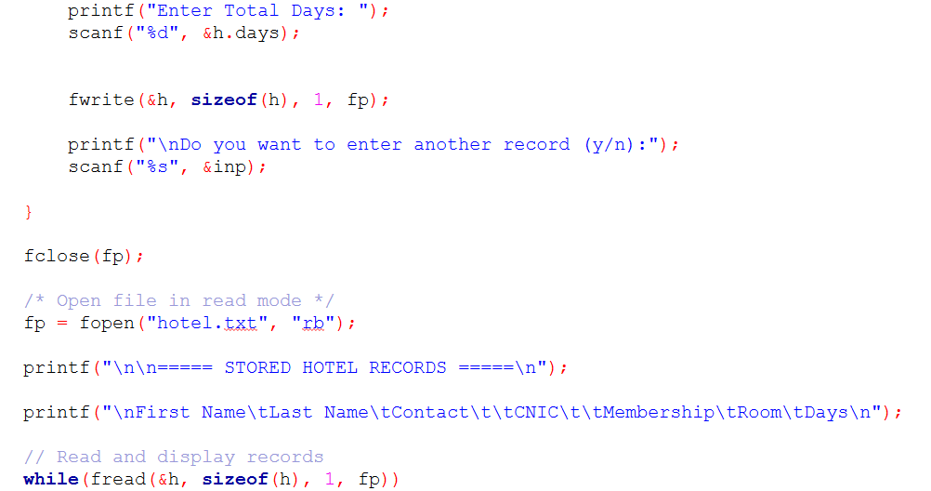
fwrite(&h, sizeof(h), 1, fp);
Saves structure data into the file.
&h → address of structure
sizeof(h) → total size of structure
1 → one record
fp → file pointer
scanf("%s", &inp);
Asks user whether to enter another record.
fclose(fp);
Closes the file after writing data.
fp = fopen("hotel.txt", "rb");
Opens file in binary read mode.
r = read
b = binary

Slide 9
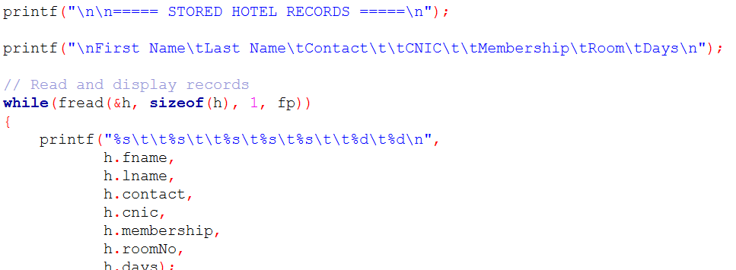
while(fread(&h, sizeof(h), 1, fp))
Reads records from file one by one.
Loop continues until all records are read.
printf("%s\t\t%s\t\t%s ...");
Displays stored customer information on screen.

Slide 10
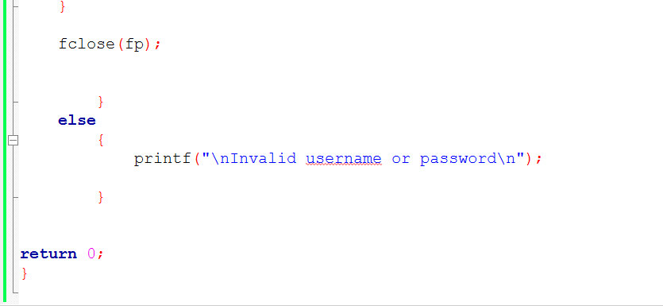
fclose(fp);
Closes the file after reading.
else { printf("\nInvalid username or password\n"); }
If login details are wrong, error message is displayed.

Slide 11
Overall Working of Program
User enters login details.
Program checks username and password.
User enters hotel customer records.
Records are stored in a file using file handling.
Program reads data from file.
All saved records are displayed on the screen.

